Slide 1
Lectuer-8 Database Design and Applications
Ashish Narang

Slide 2
First Semester
2020-21

Slide 3
Database Storage
The collection of data that makes up a database must be stored physically on some storage medium.
Computer Storage media includes two main categories.
Primary Storage
Secondary Storage

Slide 4
Disk Storage
Magnetic disks are used for storing large amounts of data.
The capacity of disk is the number of bytes it can store.
To increase storage capacity disks are assembled into a disk pack which contains several magnetic disks connected to a rotating spindle.
Disks are divided into concentric circular tracks on each disk surface.

Slide 5
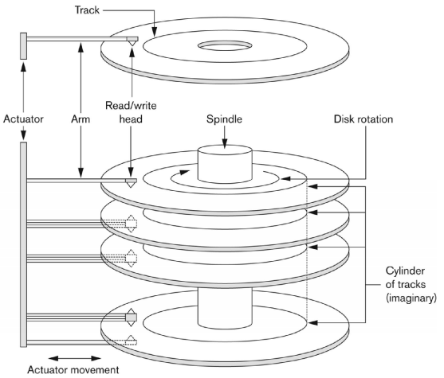
Disk and Disk Pack

Slide 6
Contd..
In disk packs, tracks with same diameter on various surfaces are called a cylinder.
Track is further divided into sectors.
The division of track into sectors is hardcoded on the disk surface and cannot be changed.
Further a track is divided into blocks. Whole blocks are transferred between main memory and disk for processing.

Slide 7
Contd..
A read/write head moves to the track that contains the block to be transferred.
Disk rotation moves the block under the read/write head for reading or writing
A disk block address consists of cylinder number, track number and a block number.
Reading or Writing a disk block involves 3 types of latencies.
Seek time
Rotational latency
Block Transfer Time

Slide 8
Contd..
Seek Time is the time required to position the read/write head on the correct track.
Rotational latency is the time required to position the read/write head at the beginning of the desired block.
The time needed to transfer the data from disk to main memory is called rotational latency.

Slide 9
Files and Records
A file is a sequence of records, where each record is a collection of data values.
Records represent entities.
Records can be of fixed length as well as variable length.
In fixed length records, every record type has exactly same size while in variable length record types may have different sizes.

Slide 10

Fixed and Variable Length Records

Slide 11
Contd..
Records are stored in disk blocks.
The average number of records stored in a block is called blocking factor.
Further records can be spanned and unspanned.
In case of unspanned records no record can span two blocks
In case of spanned, a record can be stored in more than one block.

Slide 12
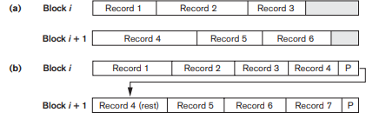
Spanned and UnSpanned Records

Slide 13
Unordered Files
Records are placed in the file in order in which they were inserted.
New records are inserted at the end of the file
Searching a record involves linear search through the file which is expensive in case of large files.

Slide 14
Ordered Files
Records of a file are ordered based on one of the fields called ordering field.
Search based on the value of ordering key field results in faster access when binary search technique is used.
Inserting and Deleting the records are expensive operations because records must remain physically ordered.

Slide 15
Hashing
It’s a technique which provides fast access to records based on search key.
The search is based on the filed called hash key.
The idea behind hashing is to provide a function h called hash function, which is applied to the hash field value of record and yields the address of block in which the record is stored.

Slide 16
Internal Hashing
Hashing is typically implemented as a hash table through the use of an array of records.
Suppose that the array index range is from 0 to M – 1; then we have M slots whose addresses correspond to the array indexes.
We choose a hash function that transforms the hash field value into an integer between 0 and M − 1.
One common hash function is the h(K) = K mod M function, which returns the remainder of an integer hash field value K after division by M

Slide 17
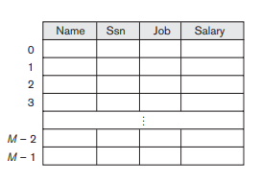
Contd..

Slide 18
Collision
A record that is being inserted hashes to an address that already contains a different record, then it is said to have collision.
Then we need to find some other location for the new record. This process is known as collision resolution.

Slide 19
Methods of Collision Resolution
Open addressing: When collision occurs try with alternate cells until an empty cell is found.
Chaining: For this various overflow locations are kept by extending the array by number of overflow positions. A pointer field is added to each record location. Collision is resolved by allocating an unused overflow position.
Multiple hashing: We apply a second hash function if the first hashing results in a collision.

Slide 20
External Hashing
Hashing for disk files is called external hashing.
The disk space is made of buckets, each of which holds multiple records.
A bucket is either one disk block or a cluster of contiguous disk blocks.
The hashing function maps a key into a relative bucket number, rather than assigning an absolute block address to the bucket.
A table maintained in the file header converts the bucket number into the corresponding disk block address

Slide 21
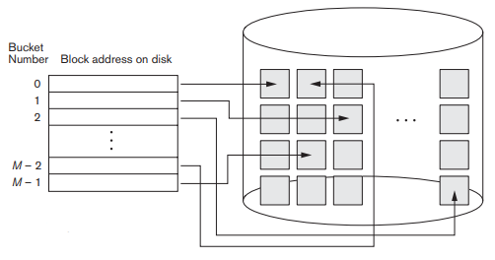
Contd..

Slide 22
Contd..
The above scheme is called as static hashing because the number of buckets allocated is fixed. This is a big constraint for files that are dynamic.
When a bucket is filled to capacity and if the new record is hashed on to the same bucket, then chaining is adopted, where a pointer is maintained in each bucket to a linked list of overflow records for the bucket.

Slide 23
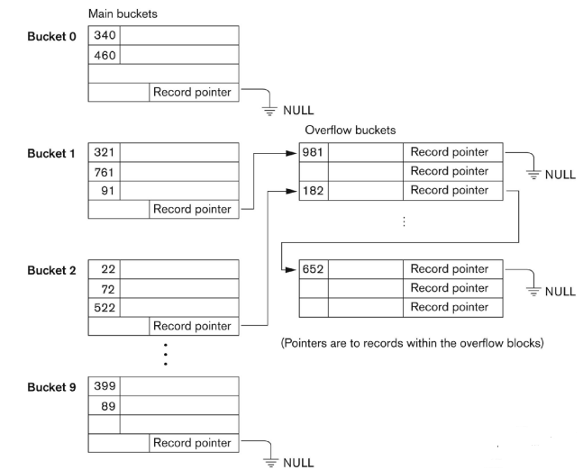
Handling Overflows

Slide 24
Extendible Hashing
In extendible hashing, a type of directory—an array of 2^{d} bucket addresses—is maintained, where d is called the global depth of the directory.
The integer value corresponding to the first (high-order) d bits of a hash value is used as an index to the array to determine a directory entry, and the address in that entry determines the bucket in which the corresponding records are stored.
A local depth ld stored with each bucket—specifies the number of bits on which the bucket contents are based.

Slide 25
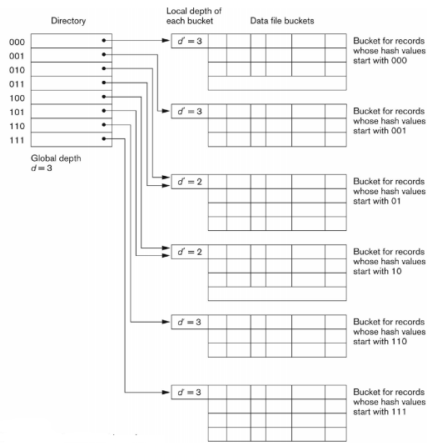
Contd..

Slide 26
Linear Hashing
In Linear Hashing, no directory structure is used.
Instead of one hash function, multiple hash functions are used.
When collision occurs with one hash Linear Hashing function, the bucket overflows is split in to two and the records in the original buckets are distributed among two buckets using the next hash function h(i +1) (k).

